Slide 1
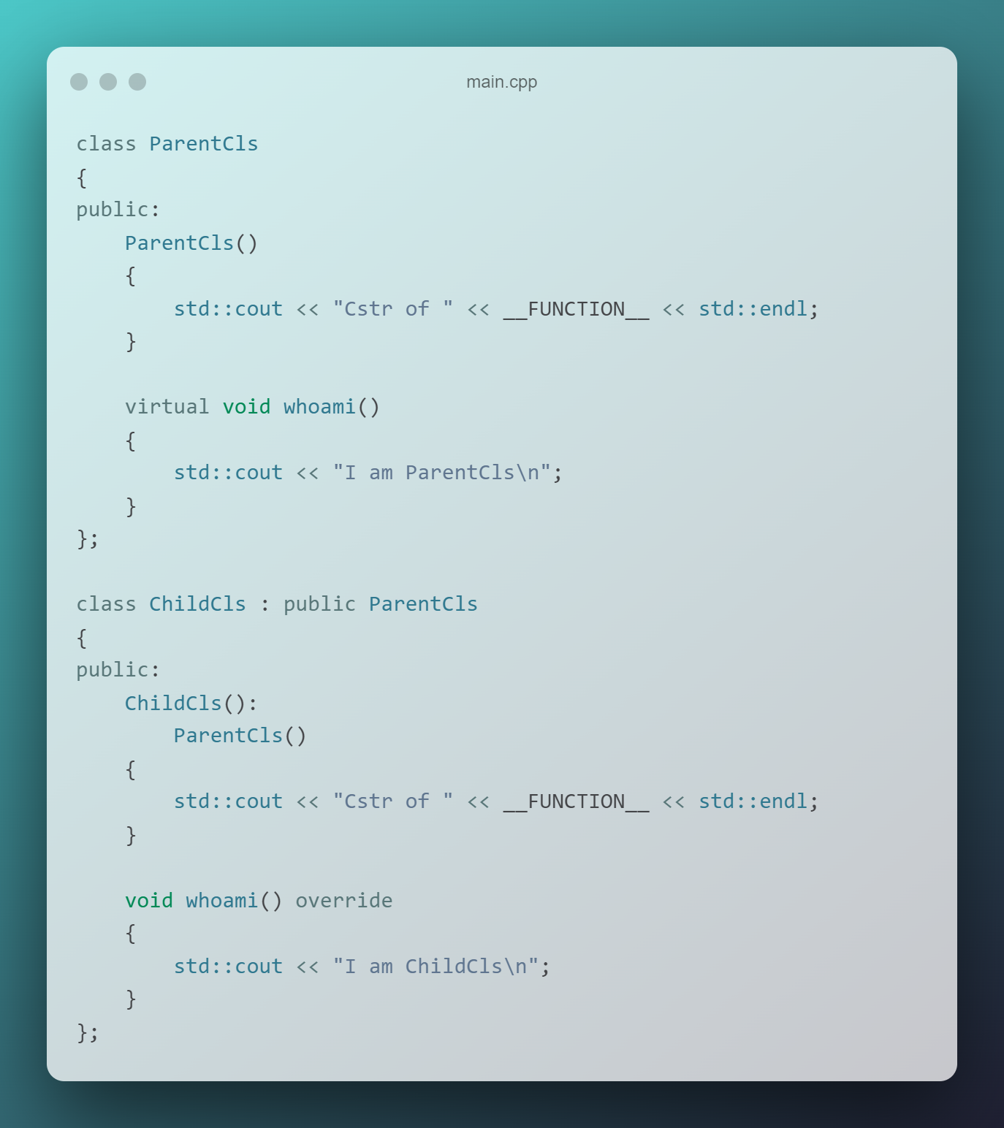
Inheritance
Inheritance is a feature or a process in which, new classes are created from the existing classes.
The derived class now is said to be inherited from the base class.

Slide 2
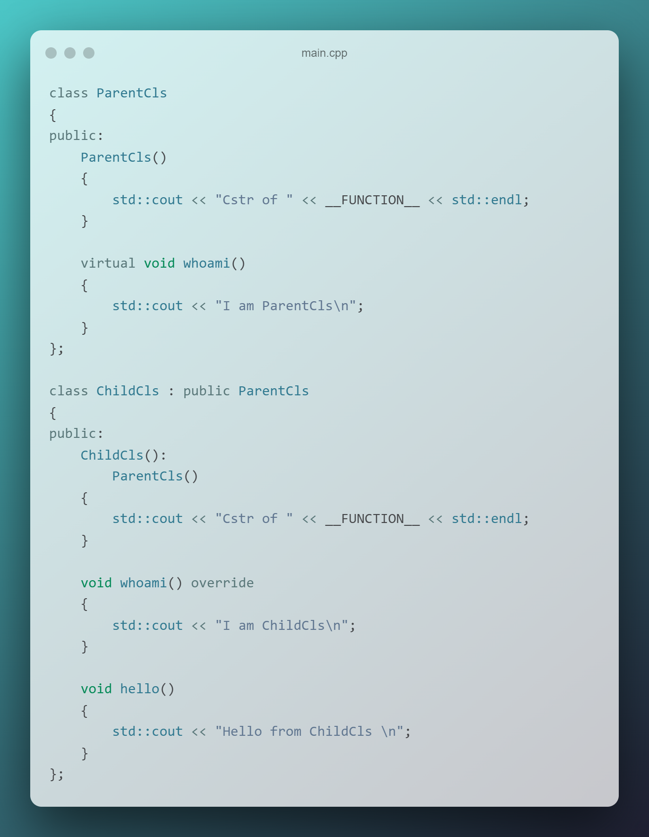
The derived class inherits all the properties of the base class, without changing the properties of base class without changing the properties of base class and can add new features to its own.
New features will not affect the base class! Link to example - snippet_on_godbolt

Slide 3
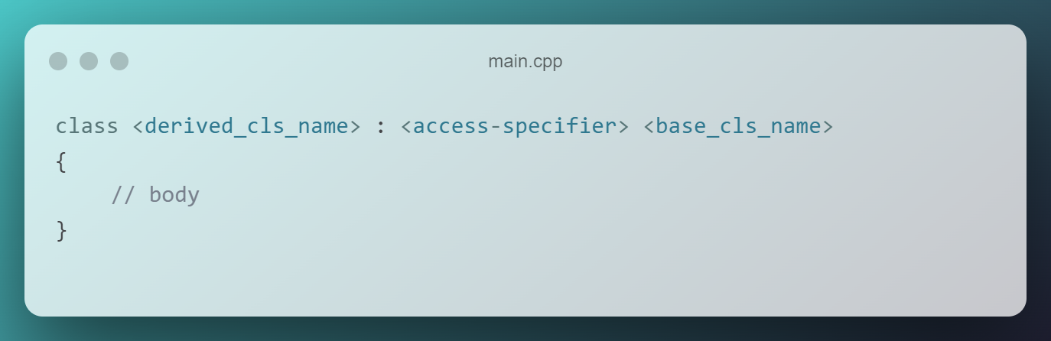
Modes of inheritance
Private (by default)
Protected
Public
Base class member access specifier | Type of inheritance
 | public | protected | private
public | public | protected | private
protected | protected | protected | private
private | Not accessible (hidden) | Not accessible (hidden) | Not accessible (hidden)

Slide 4
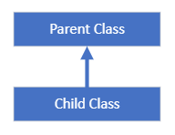
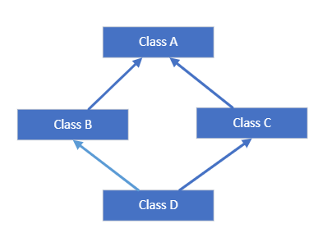
Type of inheritance
Single inheritance
Multiple inheritance

Slide 5
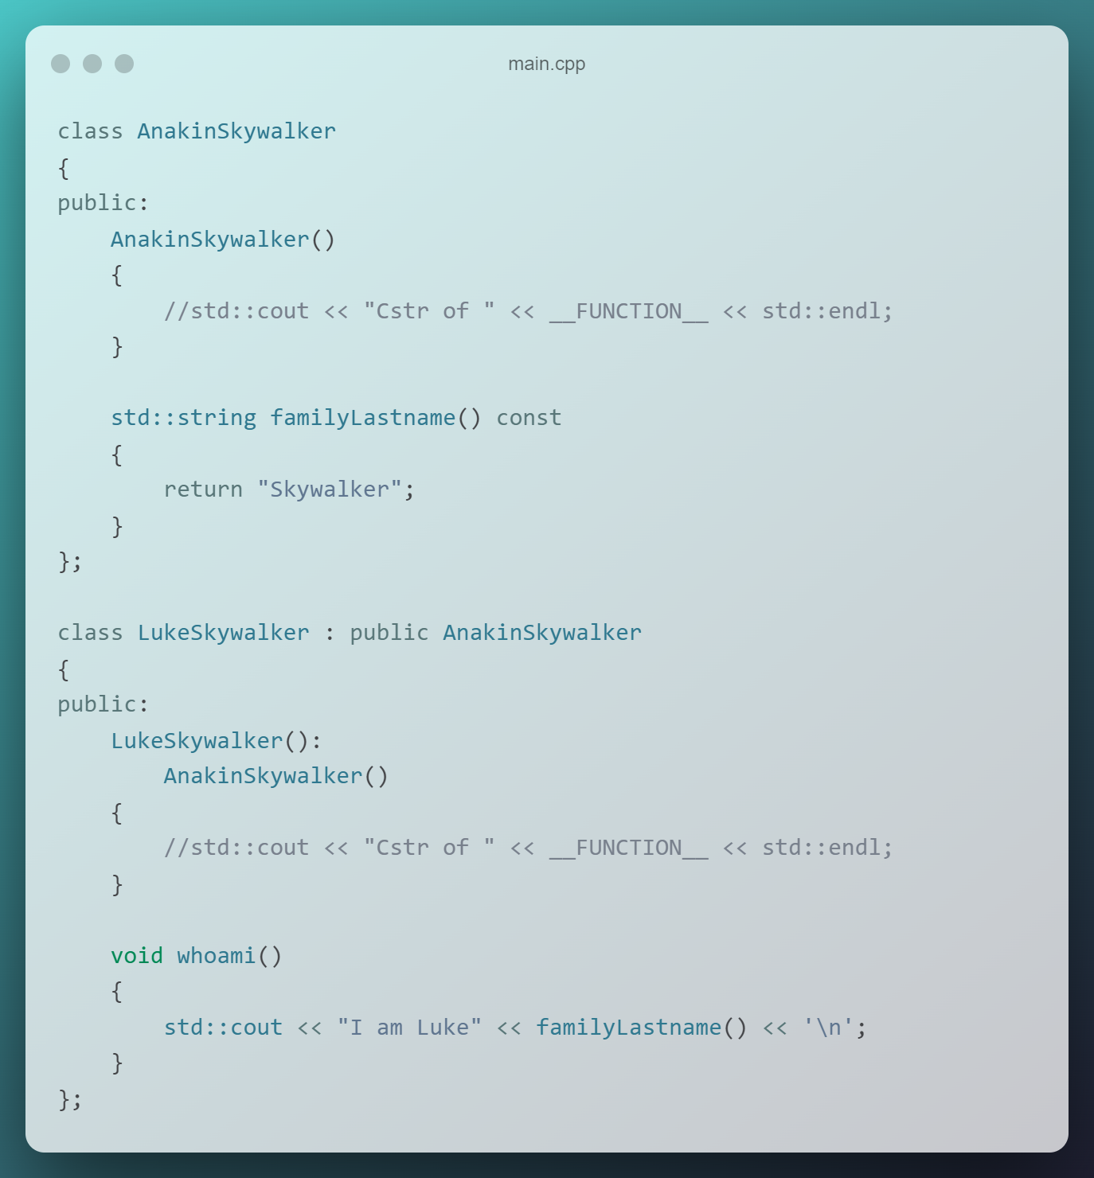
Single inheritance
In single inheritance, a class is allowed to inherit from only one class. i.e., one subclass is inherited by one base class only.

Slide 6
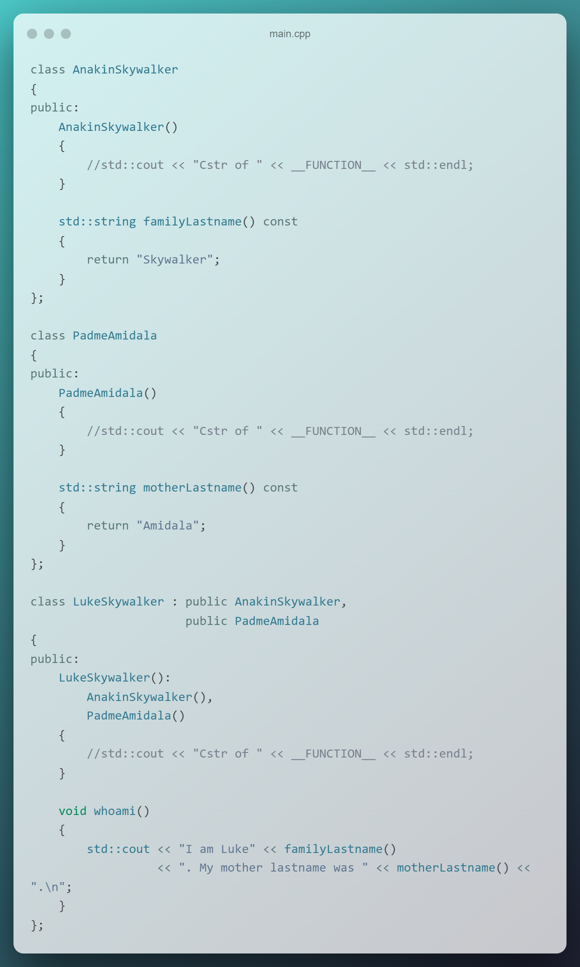
Multiple inheritance
The class derives features from more than one parent object/parent class.
Multiple inheritance can increase complexity and ambiguity in situation knows as „diamond problem”.
Link to full example - snippet_on_godbolt

Slide 7
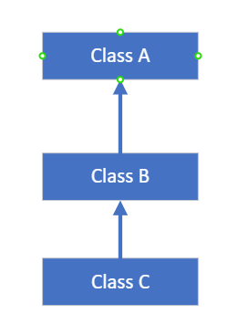
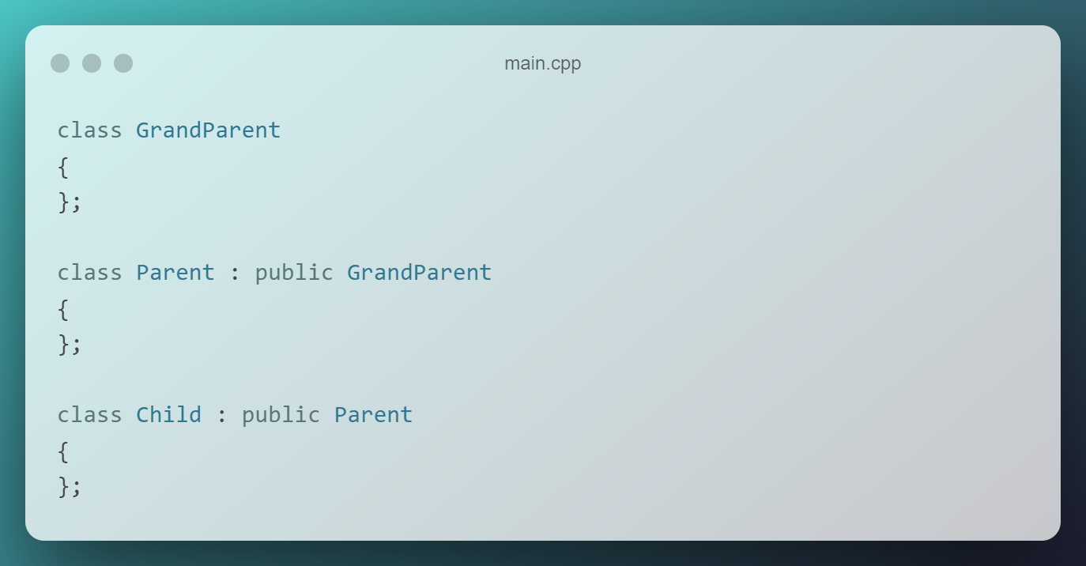
Multi-level inheritance
In this type of inheritance, a derived class is created from another derived class.

Slide 8
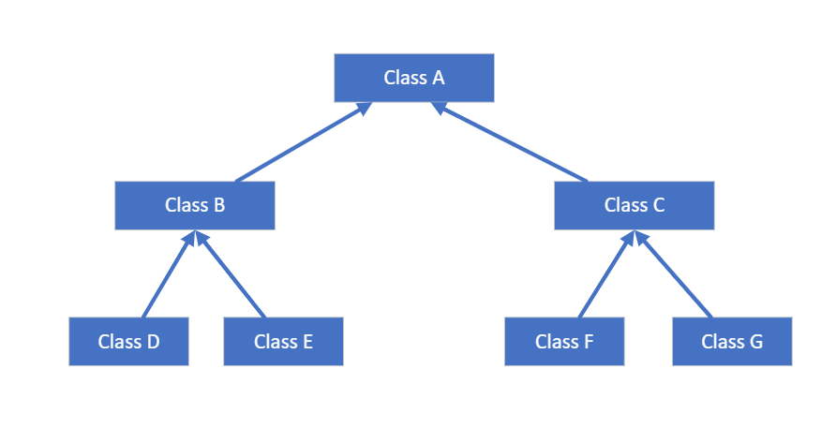
Hierarchical inheritance
In this type of inheritance, more than one subclass is inherited from a single base class. i.e. more than one derived class is created from a single base class.

Slide 9
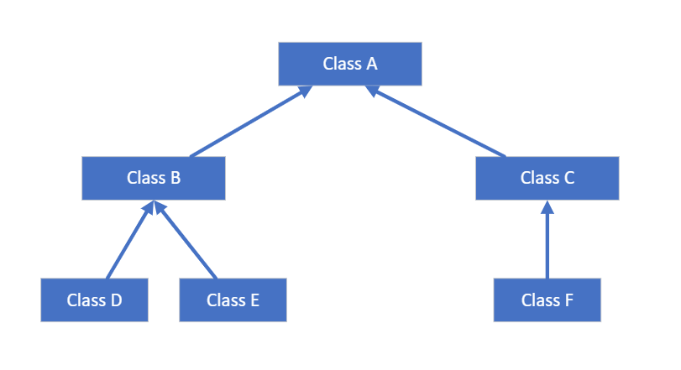
Hybrid inheritance
Hybrid Inheritance is implemented by combining more than one type of inheritance.
For example: Combining Hierarchical inheritance and Multiple Inheritance.

Slide 10
Diamond problem
The diamond problem is an ambiguity that arises when two classes B and C inherit from class A and class D inherits from both B and C.
If there is a method in A that B and C have overridden, and D does not override it, then which version of the method does D inherit?
From class A?
From class B?

Slide 11
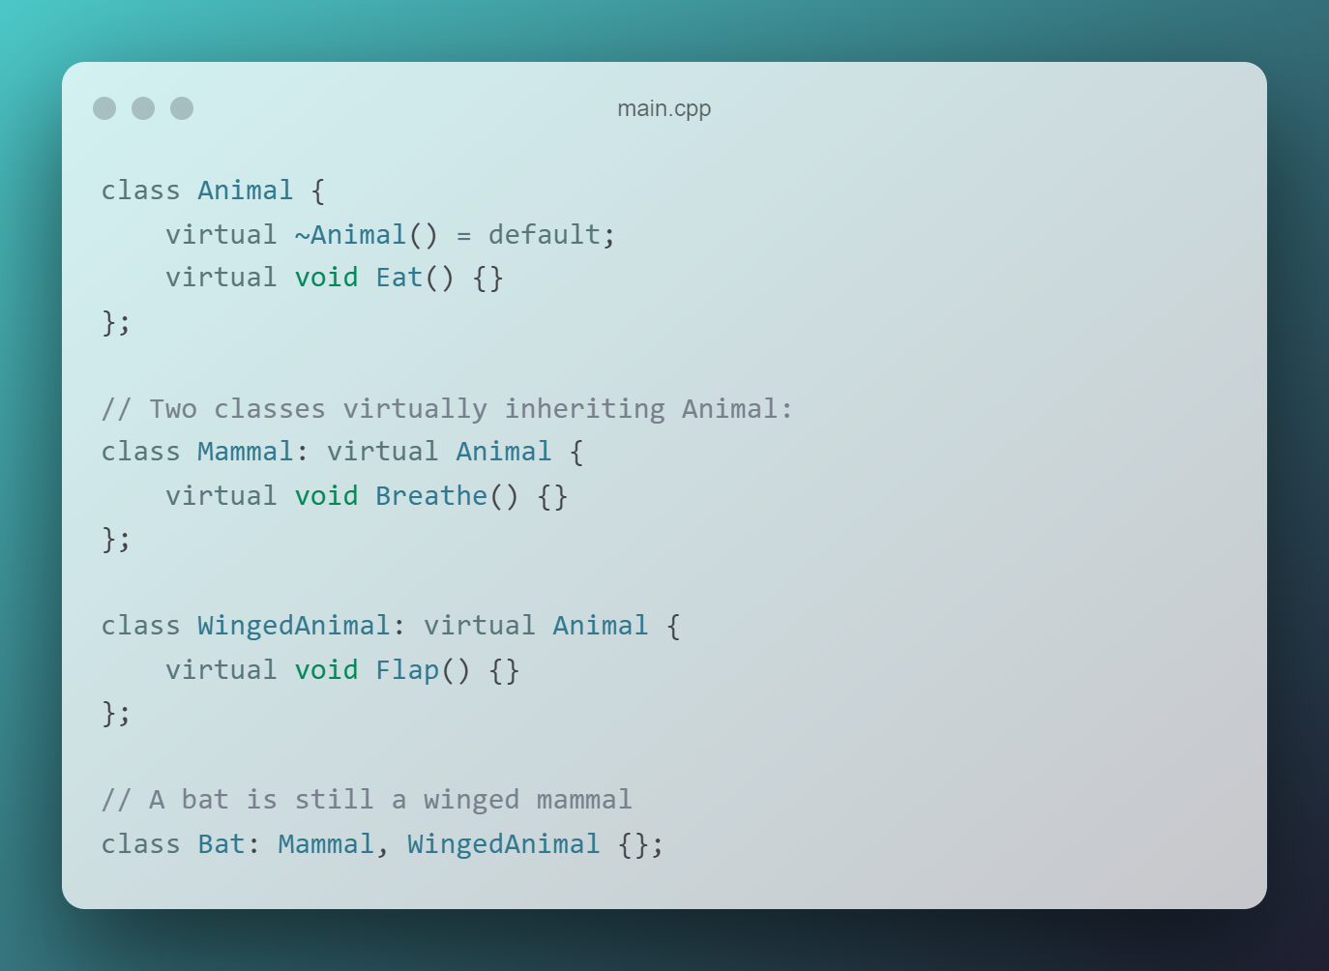
How avoid Diamond problem?
Use virtual inheritance, that ensures only one copy of base class’s member variables are inherited by grandchild derived classes.
In our case, it is class D.

Slide 12
☕🍖

